Slide 1

NUTRIENT ANALYSIS AND RECOMMENDATION SYSTEM FOR HEALTH AND FITNESS USING AI & IOT
TEAM MEMBERS:
SURENDHAR S (210701271)
TARUNVISHAAL L (210701285)
SRI SAI B (210701258)

Slide 2

ABSTRACT
Our model proposes a nutrient analysis and recommendation system designed to empower individuals in their specific health and fitness goals. This project employs AI algorithms to analyze nutritional content, leveraging data from IoT devices. This system provides users with comprehensive insights into their nutrient consumption, including macronutrients, vitamins, and minerals. Our model is designed to provide dietary recommendations based on individual user profiles, incorporating personal information such as age, height, weight, Body Mass Index (BMI), and fitness objectives.

Slide 3
EXISTING SYSTEM
The existing system uses Open CV algorithm for classifying the fruits images . The dataset contains only 10 classes of fruits. It just display the calories of the predicted image and it lacks in analyzing the nutrients present in the respective fruit. Also this system does not recommend the amount of nutrients to be consumed based on the BMI of the user.

Slide 4
PROPOSED SYSTEM
Our Proposed system receives the input image from the user using ESP32 camera module integrated with Arduino. The dataset contains 20 different classes of both fruits and vegetables. Our model predicts the image by using CNN algorithm. This system recommends the amount of nutrients to be consumed by calculating Body Mass Index value with the help of height, weight of the user. This recommendations empower individuals in their specific health and fitness goals.

Slide 5
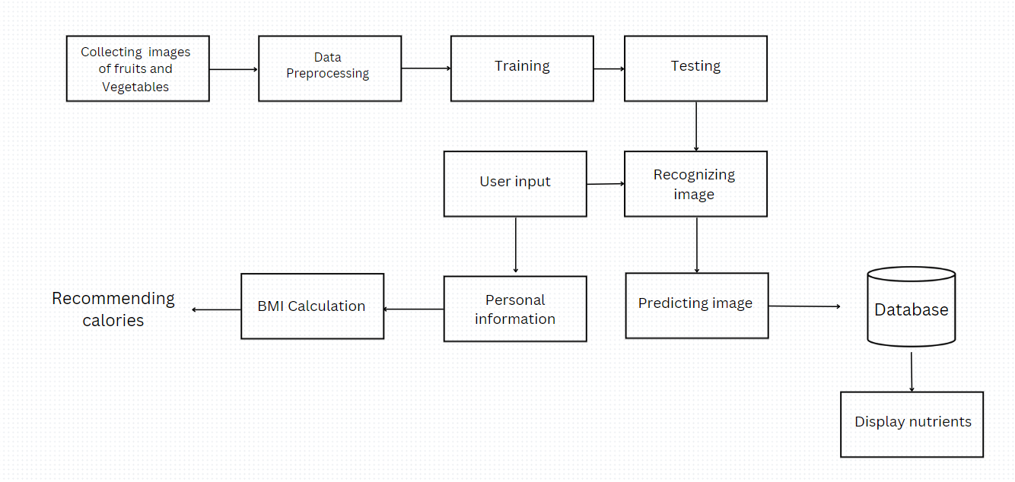
SYSTEM ARCHITECTURE

Slide 6
MODULES
User Input: The image of fruit or vegetable that has been shown by the user has been captured with the help of ESP32 camera integrated with Arduino.
Data Collection: Data collection is the next step to predict the fruits and vegetables . It is the process of collecting the images of different categories of fruits and vegetables from the google and stored in the respective categories.
Image preprocessing: Only the image of the fruits and vegetables is extracted from the collected image. Background of the image is removed .Finally we get only the fruits or vegetable image with no background image so that it is easy for the model to predict the image.

Slide 7
MODULES
Segmentation: First the input image is converted into grayscale. The images of grayscale contains only the sensitive information. The mathematical function is used to acquire the gray value of the pixel. Finally we get the segmented image of fruits or vegetables.
Recognition: Image classification technique is done with the help of CNN algorithm with the help of the dataset where the dataset is split into training, testing, validation set. 70% of the images are used for training,15% for testing,15% for validation. Thus our model predict the images received grom the user
Collecting Personal information: Gather the personal information from the user such as weight, height and calculate BMI value. Based on BMI value the system recommend the amount of calories to be consumed to the user

Slide 8
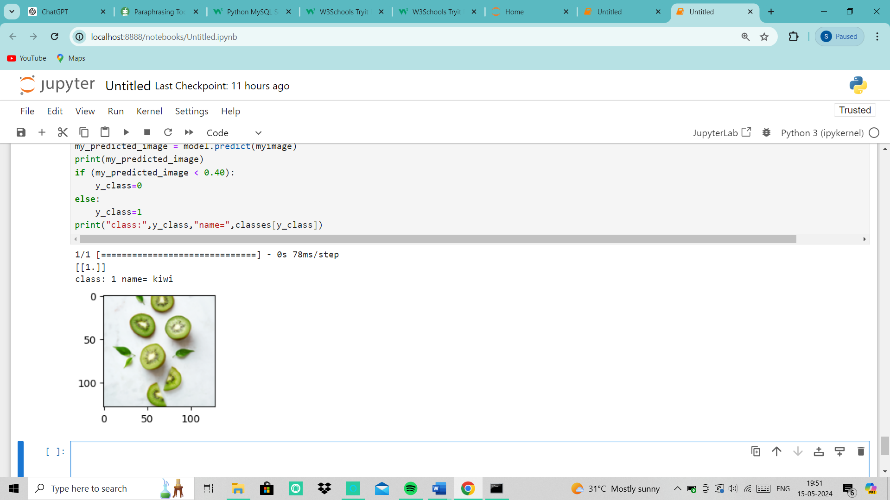
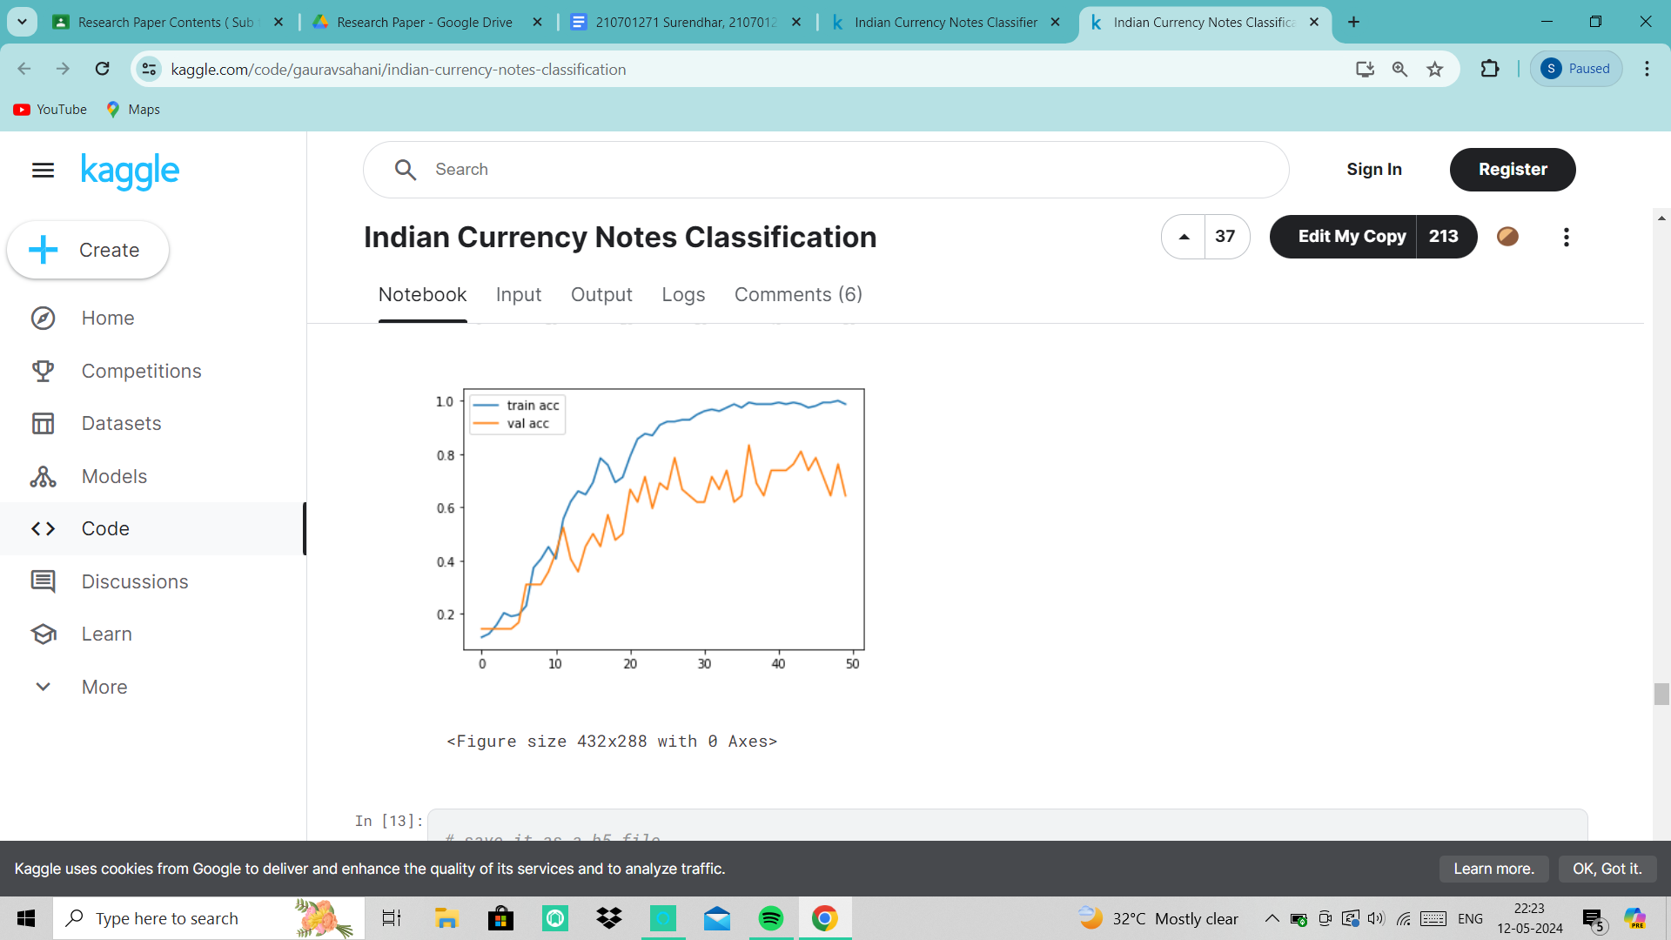
RESULT
The outcomes of the Health and Fitness Nutrient Analysis and Recommendation System AI is shown to be effective in encouraging healthy lives and offering individualized food recommendations.
PREDICTED IMAGE TRAINING AND VALIDATION
ACCURACY

Slide 9
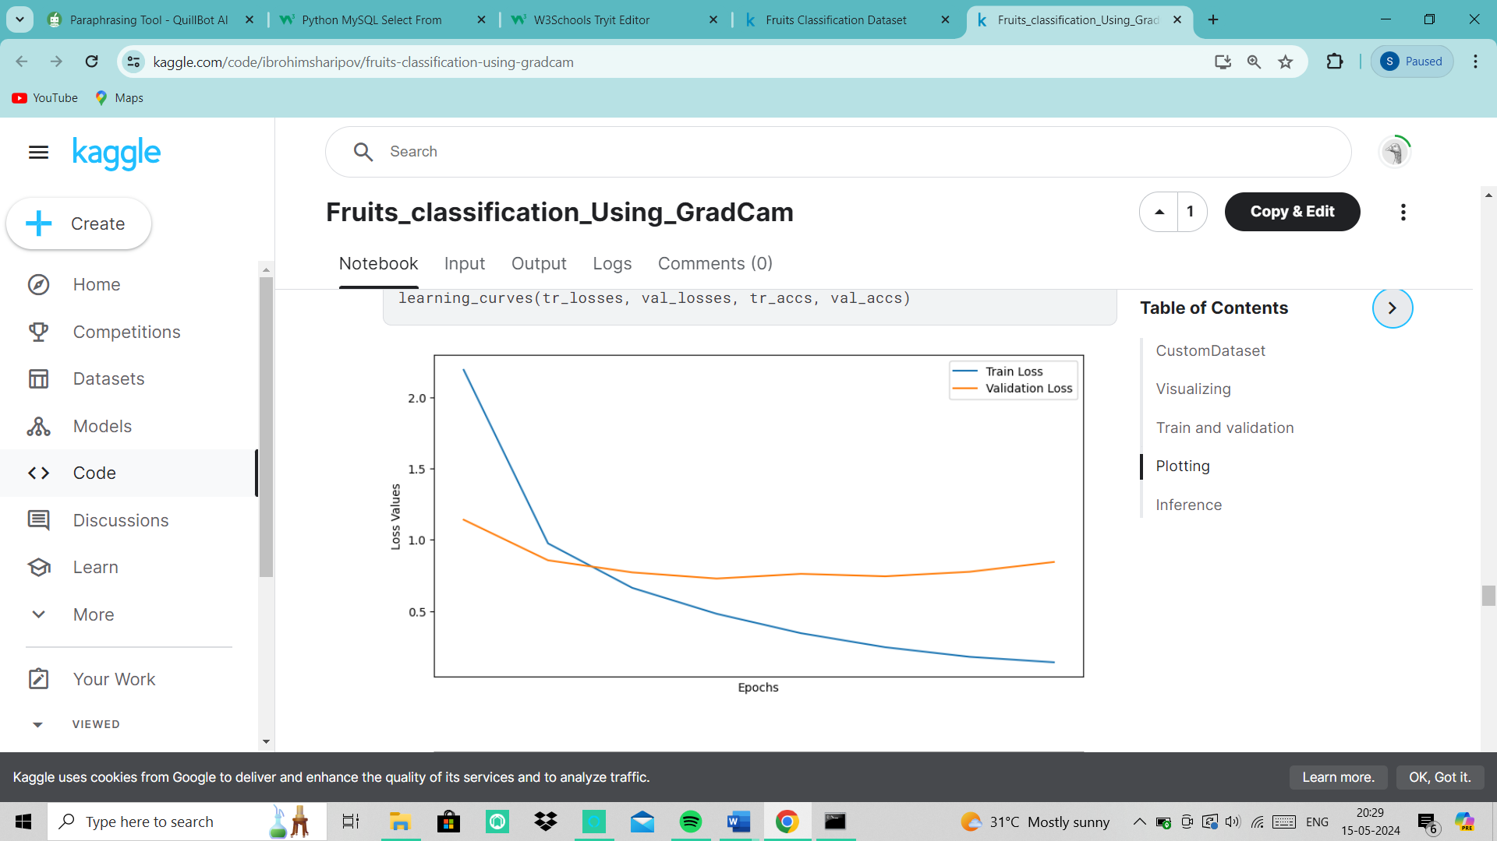
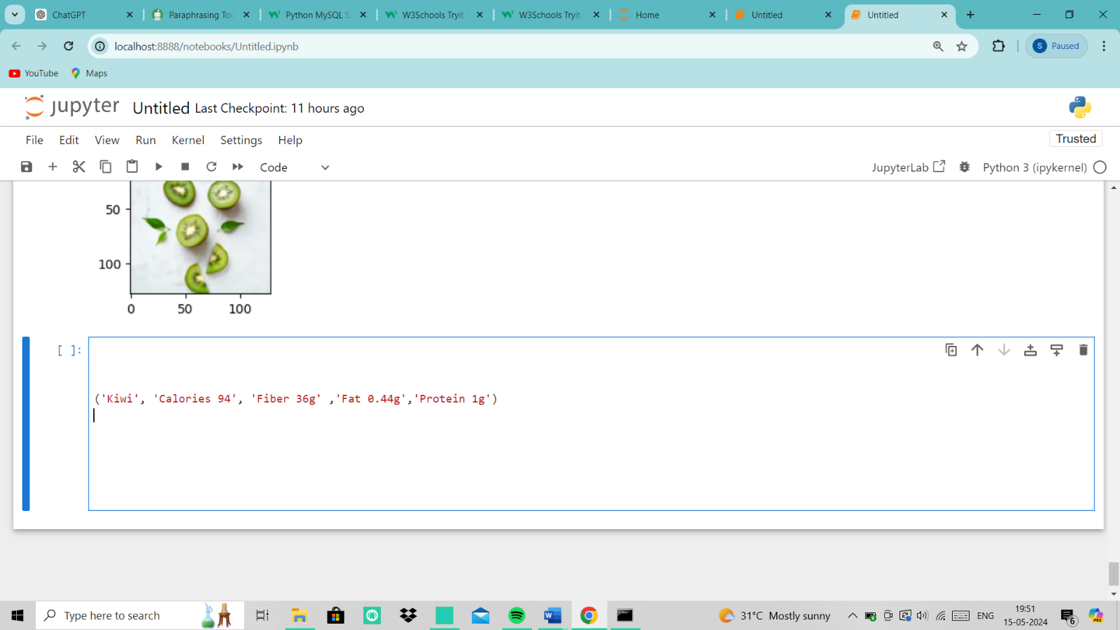
RESULT
TRAINING AND VALIDATION NUTRIENS OF PREDICTED
LOSS IMAGE

Slide 10
CONCLUSION
The Nutrient Analysis and Recommendation System for Health and Fitness concludes The application of AI marks a substantial advancement in the use of AI to encourage better living. By combining cutting-edge machine learning algorithms with Internet of Things technology, the system offers customized dietary analysis and suggestions based on user requirements and preferences. User evaluations and feedback have shown how well the system works to increase users' awareness of their nutritional intake and encourage a shift in behaviour toward healthy eating habits.

Slide 11
FUTURE ENHANCEMENTS
Integration with Fitness apps: Sync with well-known fitness platforms and applications to offer a comprehensive picture of the health of the user by combining dietary analysis and exercise data.
Nutrient deficiency alert: Use AI to provide alerts and recommendations when it detects any nutrient imbalances or deficiencies based on dietary data that has been logged and user health profiles.
Voice Assistants: Integrate with voice assistants (like Amazon Alexa, Google Assistant) for hands-free interaction and real-time nutrition advice.

